Slide 1
Statistical Methodology for
Software Engineering
Hadas Lapid, PhD
Statistics for Software
Engineers
Notes:
An Introduction to Statistical Methods and Data Analysis 7th Edition
R. Lyman Ott Michael Longnecker
Chap. 8, 9, page 400, 445

Slide 2
Contents
• Multiple Hypothesis Testing
• Intro to Analysis of Variance
Reference:
https://en.wikipedia.org/wiki/Multiple_comparisons_probl
em https://en.wikipedia.org/wiki/Family-wise_error_rate
Statistics for Software
Engineers

Slide 3
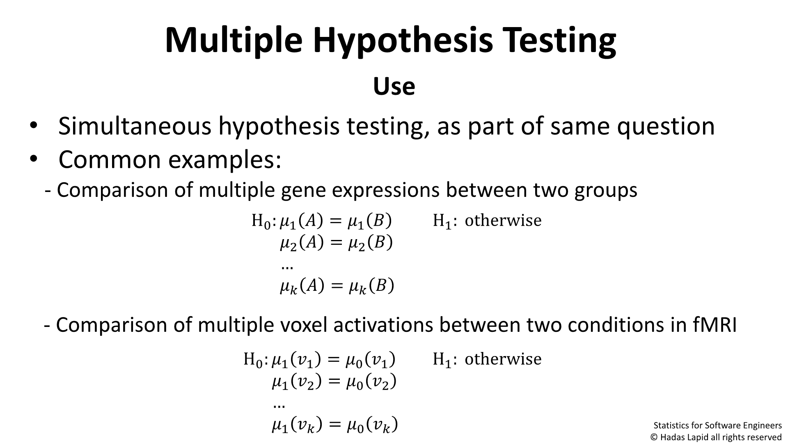










Multiple Hypothesis
Use
• Simultaneous hypothesis testing, as part of same question
• Common examples:
- Comparison of multiple gene expressions between two groups
H:ꢀ
ꢀ
ꢀ
=ꢀ₁
=ꢀ₂
ꢀ
ꢀ
:
H ot herwi se
1
0 1
ꢀ₂
…
ꢀꢀ
ꢀ = ꢀꢀ ꢀ
- Comparison of multiple voxel activations between two conditions in
fMRI
ꢀ₁
ꢀ
ꢀ
ꢀ₁
=ꢀ₀
=ꢀ₀
=ꢀ₀
H:ꢀ ꢀ
2
0 1
ꢀ
1
ꢀ₁ ꢀ₂
…
© Hadas Lapid all rights

Slide 4
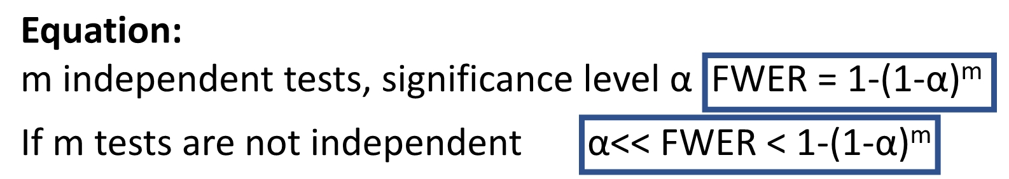


Multiple Hypothesis
Family-Wise Error Rate (FWER)
- Each comparison yields individual p-value compared to α
- H is rejected for each comparison if P <α
0
v
FWER Definition:
What is the probability of wrongly rejecting at least one null
hypothesis within this “family” of tests?
Equation:
m independent tests, significance levelFαWER = 1-(1-
If m tests are not independent
α<< FWER < 1-(1-
Statistics for Software
Engineers
Notes:
Alpha – probability of rejecting the null hypothesis
1-Alpha – probability of accepting the null hypothesis

Slide 5
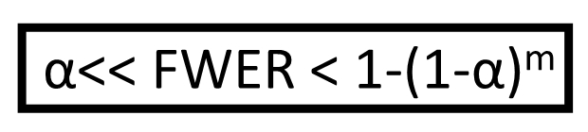

Multiple Hypothesis
The Problem
If m tests are not independent α<< FWER < 1-(1-
t-test may wrongly reject H₀’s due to the “look elsewhere effect”:
An apparently statistically significant observation may have arisen by chance
because of the size of the searched parameter space
Statistics for Software
Engineers

Slide 6
Controlling FWER Procedures
Has been approached in several methods:
• Bonferroni correction
• Holmes-Bonferroni method
• Westfall-Young method
• Hochberg’s step-up procedure
• Dunnett’s method
• Scheffe’s method
Statistics for Software
Engineers

Slide 7
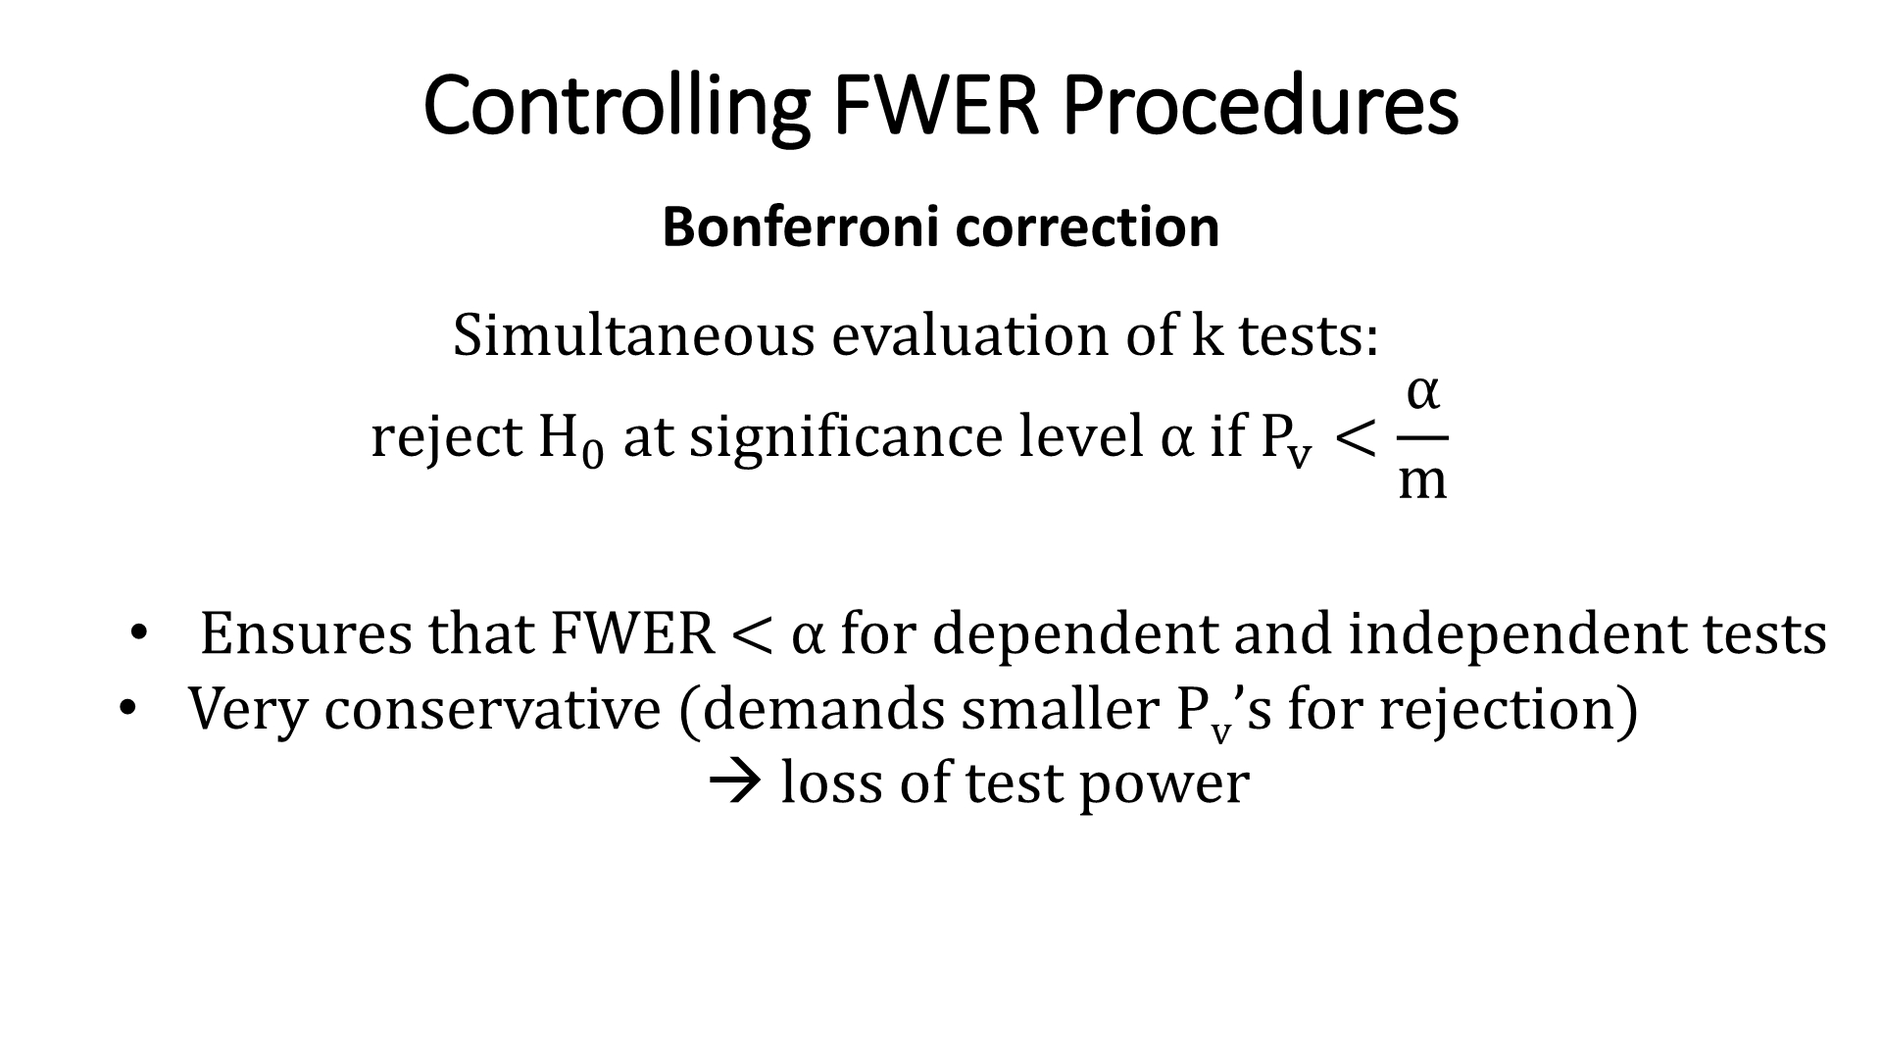
Controlling FWER Procedures
Bonferroni correction
Simultaneous evaluation of k tests:
α
rej ect H₀ at si gni fi cance l evel αif P_{v}
<
m
• Ensures that FWER <αfor dependent and independent tests
• Very conservative (demands smaller P ’sfor rejection)
→
v
loss of test power

Slide 8
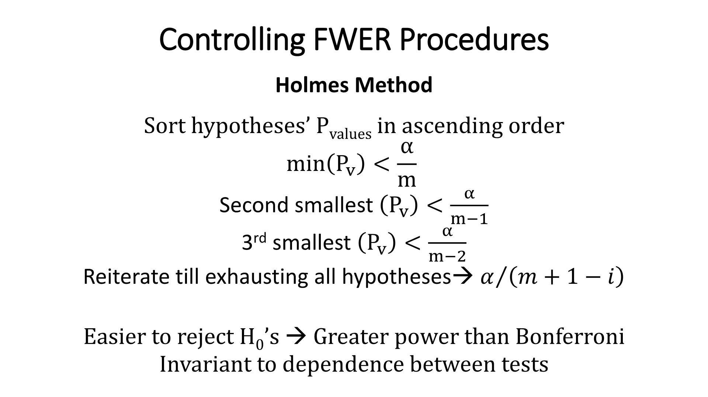




Controlling FWER Procedures
Holmes Method
Sort hypotheses’ P in ascending order
values
α
min
P_{v}
<
m
α
Second
smallest
<
^{P}v
m−1
P_{v}
α
3rd smallest
<
m−2
Reiterate till exhausting all
hypotheses
ꢀΤ
1 ꢀ
ꢀ + −
→

Slide 9
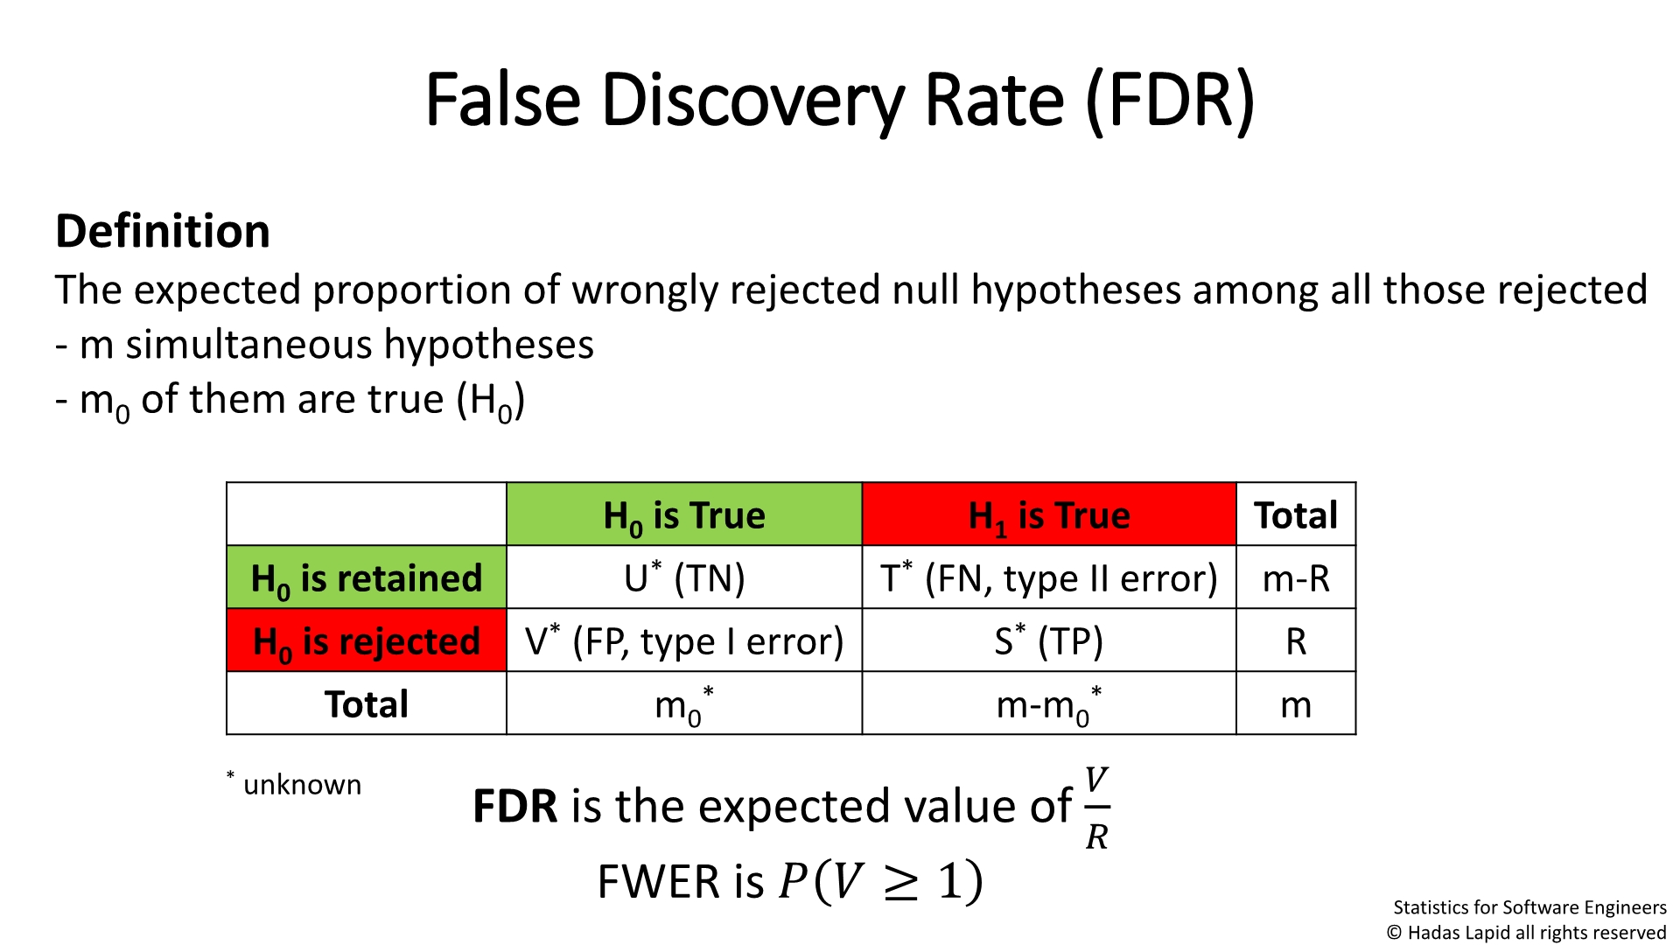
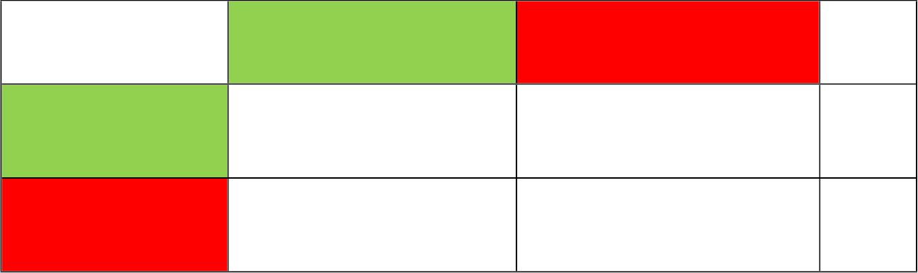
False Discovery Rate (FDR)
Definition
The expected proportion of wrongly rejected null hypotheses among all those
rejected
- m simultaneous hypotheses
- m of them are true (H )
0
0
H₀ is True
H₁ is True
Tota
l
H₀ is
retained
U* (TN)
T* (FN, type II m-R
error)
H₀ is
rejected
V* (FP, type I
error)
S* (TP)
R
Statistics for Software
Engineers

Slide 10
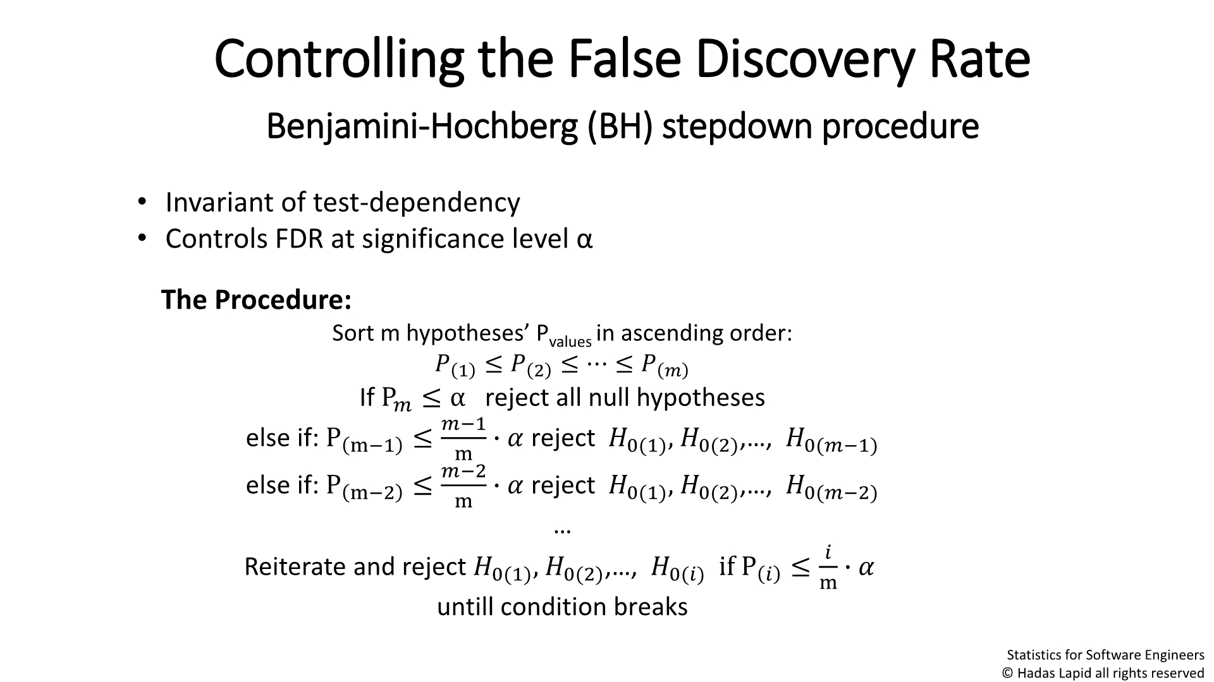
Controlling the False Discovery Rate
Benjamini-Hochberg (BH) stepdown procedure
• Invariant of test-dependency
• Controls FDR at significance level α
The Procedure:
Sort m hypotheses’ P_{values} in ascending order:
ꢀ ≤ ꢀ ≤ ⋯ ≤ ꢀ
1
2
ꢀ
If P ≤ α reject all null hypotheses
ꢀ
ꢀ−1
else if:P
else if:P
≤
≤
∙ ꢀ reject ꢀ,ꢀ ,…,
ꢀ
0
(
ꢀ−1)
m−1
m−2
m
( )
01
( )
02
^{ꢀ−2} ∙ꢀ reject ꢀ
,ꢀ0(2) ,…,ꢀ
m
0(1)
0(ꢀ−2)
…
Reiterate and reject ꢀ₀₍₁₎,ꢀ₀₍₂₎,…, ꢀ
if P
≤
ꢀ
∙ ꢀ
0(ꢀ)
ꢀ
m
untill condition breaks
Statistics for Software
Engineers

Slide 11
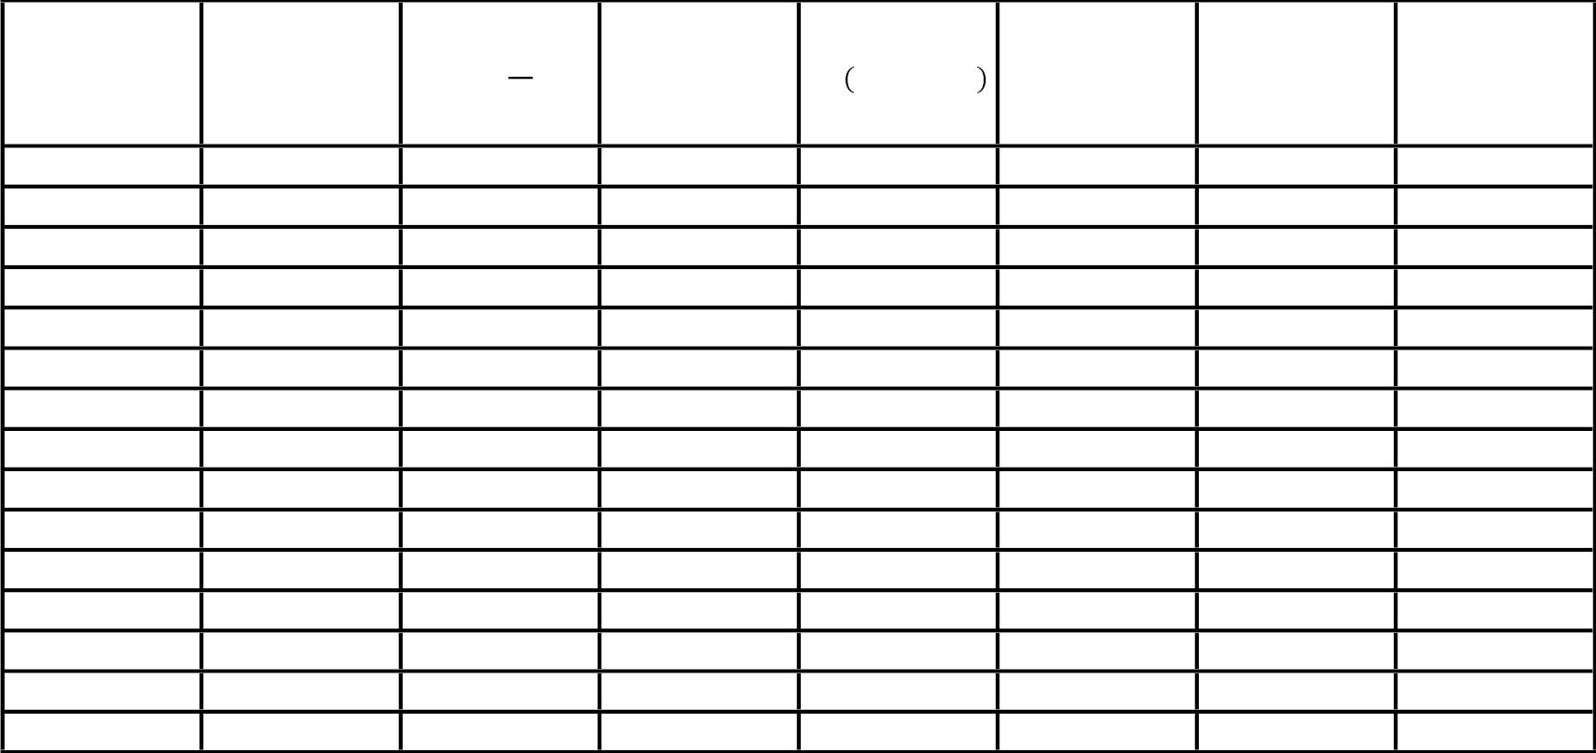
Comparison of Bonferroni, Holmes and BH Methods
test index
(i)
Bonferroni
Bonferroni
Significanc
e
Holmes
CV
Holmes
significanc
e
BH CV
ꢀ ∙ ꢀ/ꢀ
BH
significanc
Pvi
α
CV ( )
m
Τ
e
*
*
*
*
*
*
*
*
ꢀ ꢀ+1−ꢀ
1
2
3
4
5
6
7
8
9
10
11
12
13
14
15
0.0001
0.0004
0.0019
0.0037
0.0105
0.0183
0.0213
0.0253
0.0286
0.324
0.003333
0.003333
0.003333
0.003333
0.003333
0.003333
0.003333
0.003333
0.003333
0.003333
0.003333
0.003333
0.003333
0.003333
0.003333
*
*
*
0.003333
0.003571
0.003846
0.004167
0.004545
0.005
0.005556
0.00625
0.007143
0.008333
0.01
*
*
*
*
0.003333
0.006667
0.01
0.013333
0.016667
0.02
0.023333
0.026667
0.03
0.033333
0.036667
0.04
NS
NS
NS
NS
NS
NS
NS
NS
NS
NS
NS
NS
NS
NS
NS
NS
NS
NS
NS
NS
NS
NS
NS
*
NS
NS
NS
NS
NS
NS
0.4262
0.5719
0.6528
0.759
0.0125
0.016667
0.025
0.043333
0.046667
0.05
1
0.05
Controlling FDR procedures have greater power than controlling the
Statistics for Software
Engineers

Slide 12
ANOVA: Analysis of Variance
Definition
Comparison of k population means in normal variable Y
Why isn’t t-test enough?
Multiple hypothesis testing problem
Statistics for Software
Engineers

Slide 13
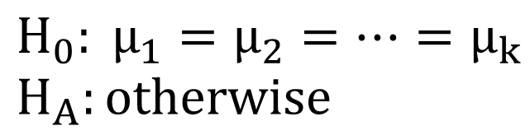
ANOVA
Model and definitions
• Normal variable Y is measured in k independent samples
• {μ_{i}, σ²} are the i^{th} population’s mean and variance
• n_{i} = population i^{th} sample size
• Yij observation j in the i^{th} sample
• n=n₁+n₂+…+n_{k}
Hypothesis testing:
H:μ = μ = ⋯ = μ
k
0
1
2
H_{A}:ot herwise
Statistics for Software
Engineers

Slide 14
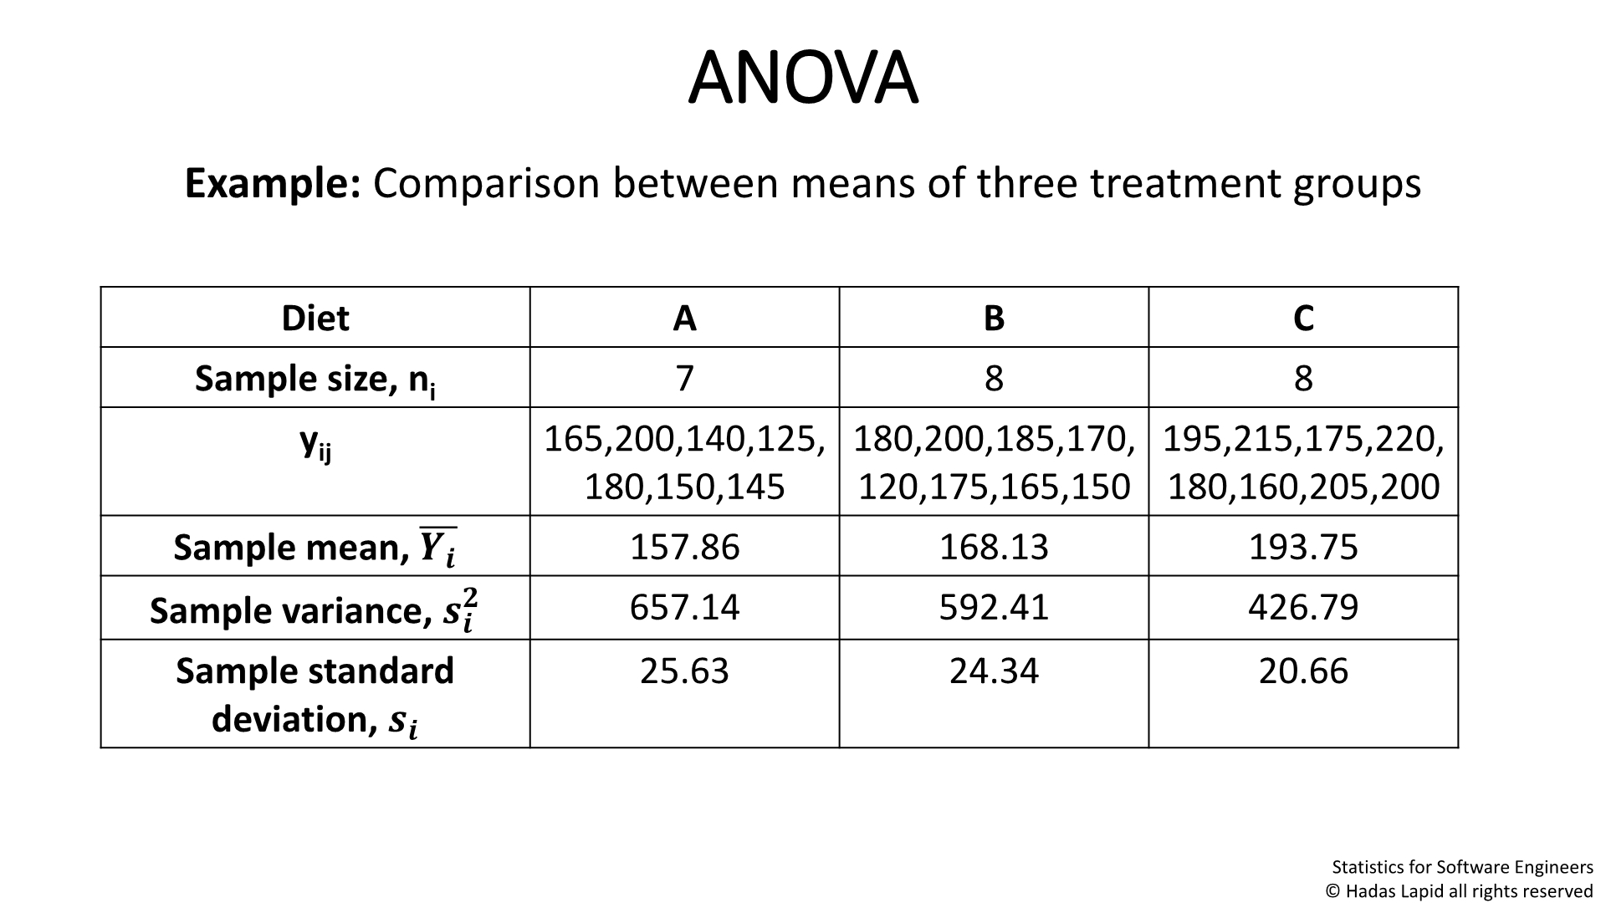
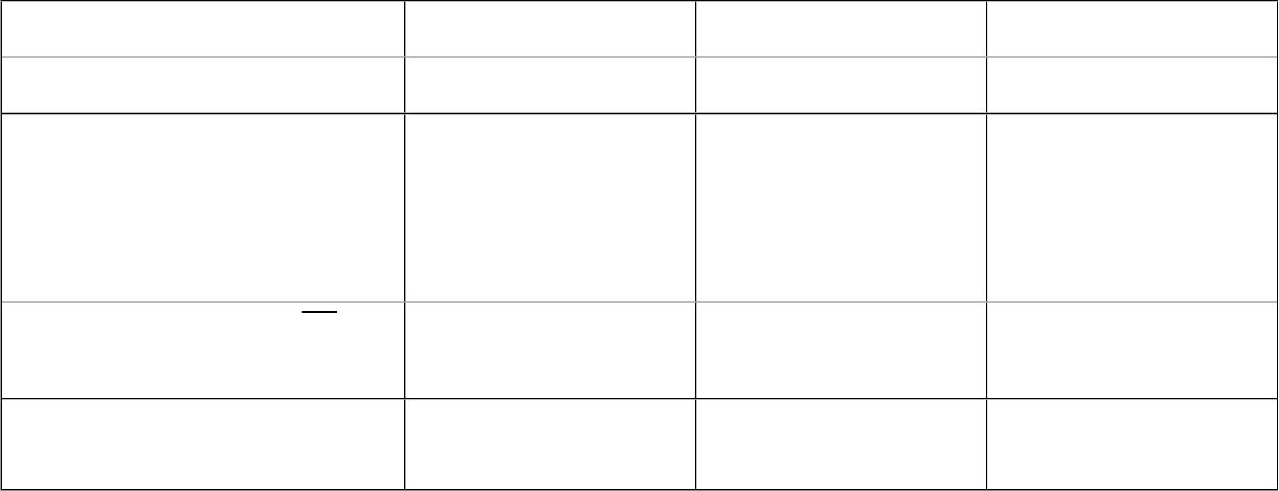
ANOVA
Example: Comparison between means of three treatment groups
Diet
A
B
C
Sample size, n_{i}
y_{ij}
7
8
8
165,200,140,12 180,200,185,17 195,215,175,22
5, 0, 0,
180,150,145 120,175,165,15 180,160,205,20
0
0
Sample mean,
ꢀꢀ
157.86
657.14
168.13
592.41
193.75
426.79
Sample variance,
ꢀꢀ
ꢀ
Statistics for Software
Engineers

